Slide 1
LnuF ROCker model prep
March 17, 2022
Roth Conrad

Slide 2
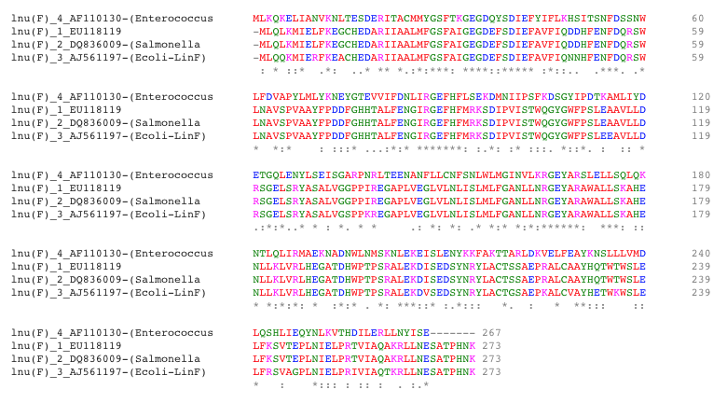
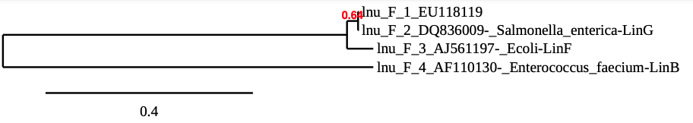
Alignment and quick phylogenetic tree of experimentally verified LnuF sequences.

Slide 3
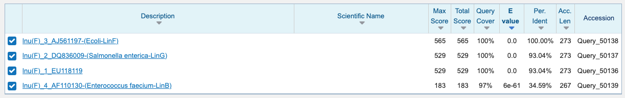
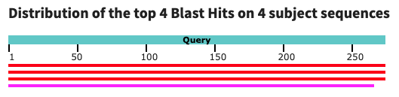
Blast result of experimentally verified LnuF sequences.

Slide 4
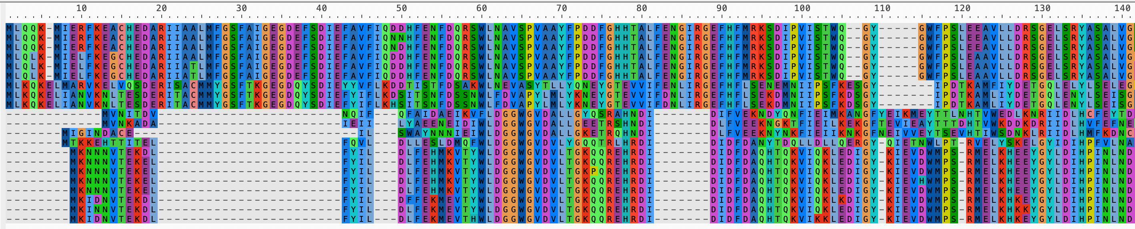
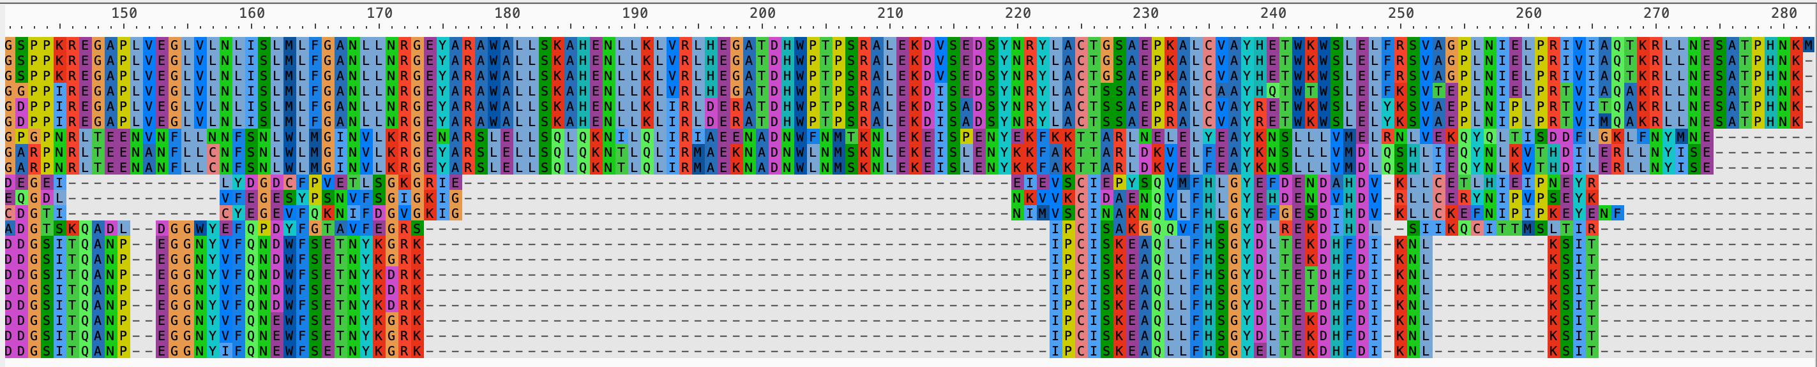
LnuA, C, D, P are clearly distinct from LnuF, B, and G
LnuF
LnuB&G
LnuC,D,P
LnuA
LnuF
LnuB&G
LnuC,D,P
LnuA

Slide 5
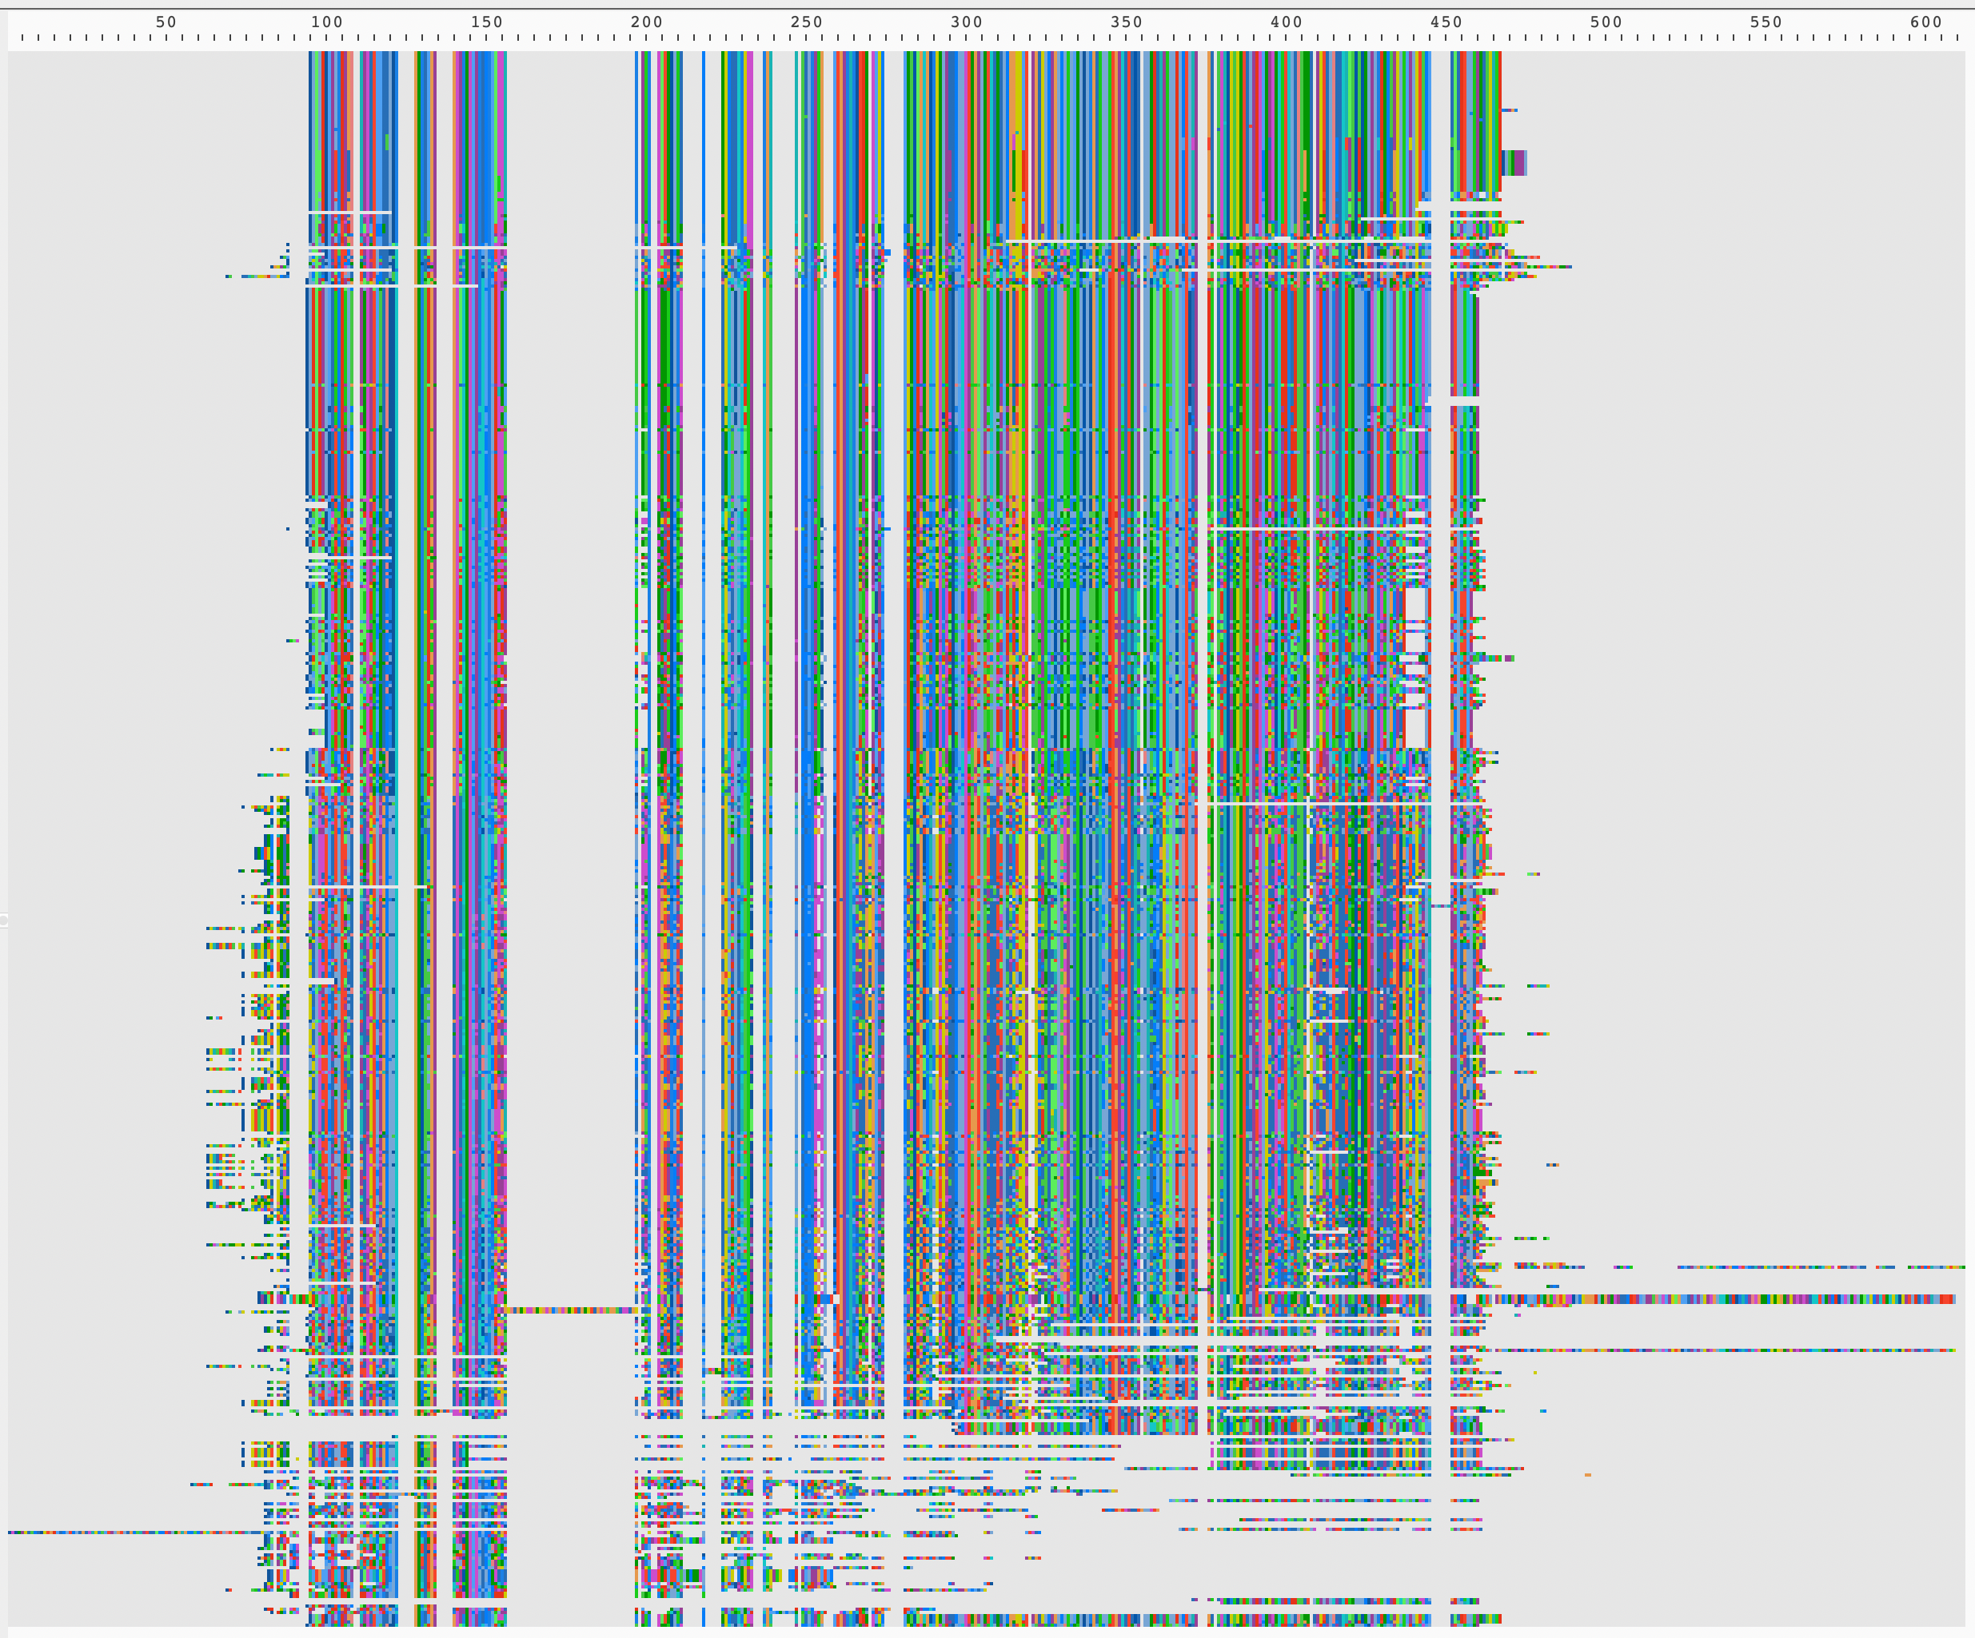
Alignment AFTER Blast Filtering
AND Deduplication.
> qsub -v verified=01_Retrieved_Sequence/lnuF_OGs-rename.faa,newseqs=01_Retrieved_Sequence/LnuF_Blast_Similar_vs_Verified_blast_fltrd.fasta ../00b_PBS/00b_clustalo.pbs

Slide 6
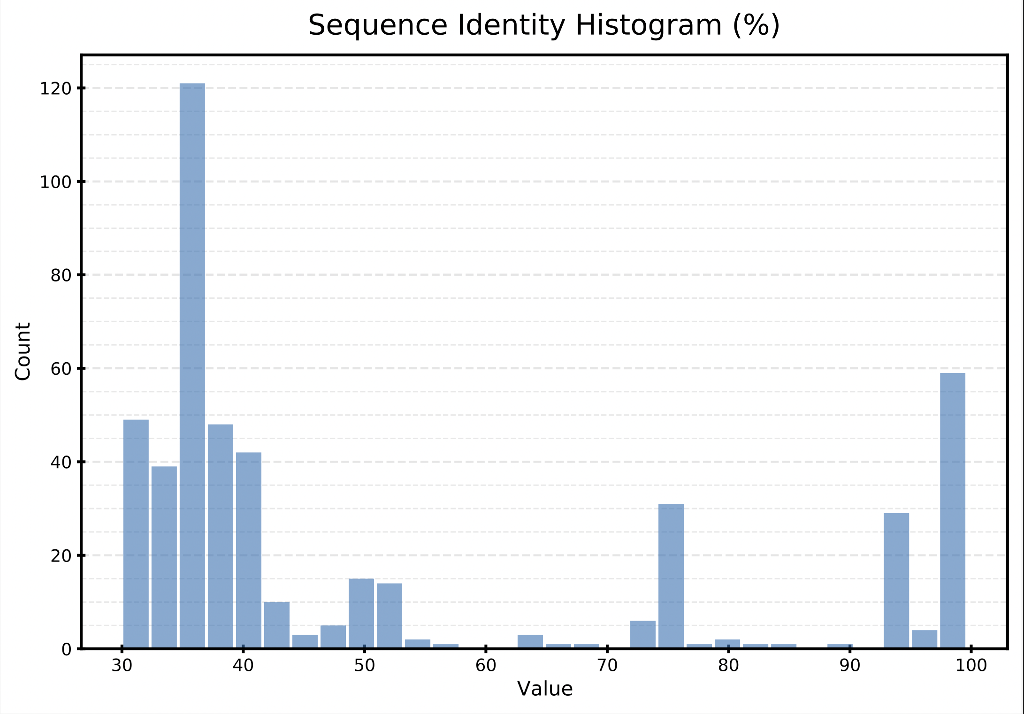
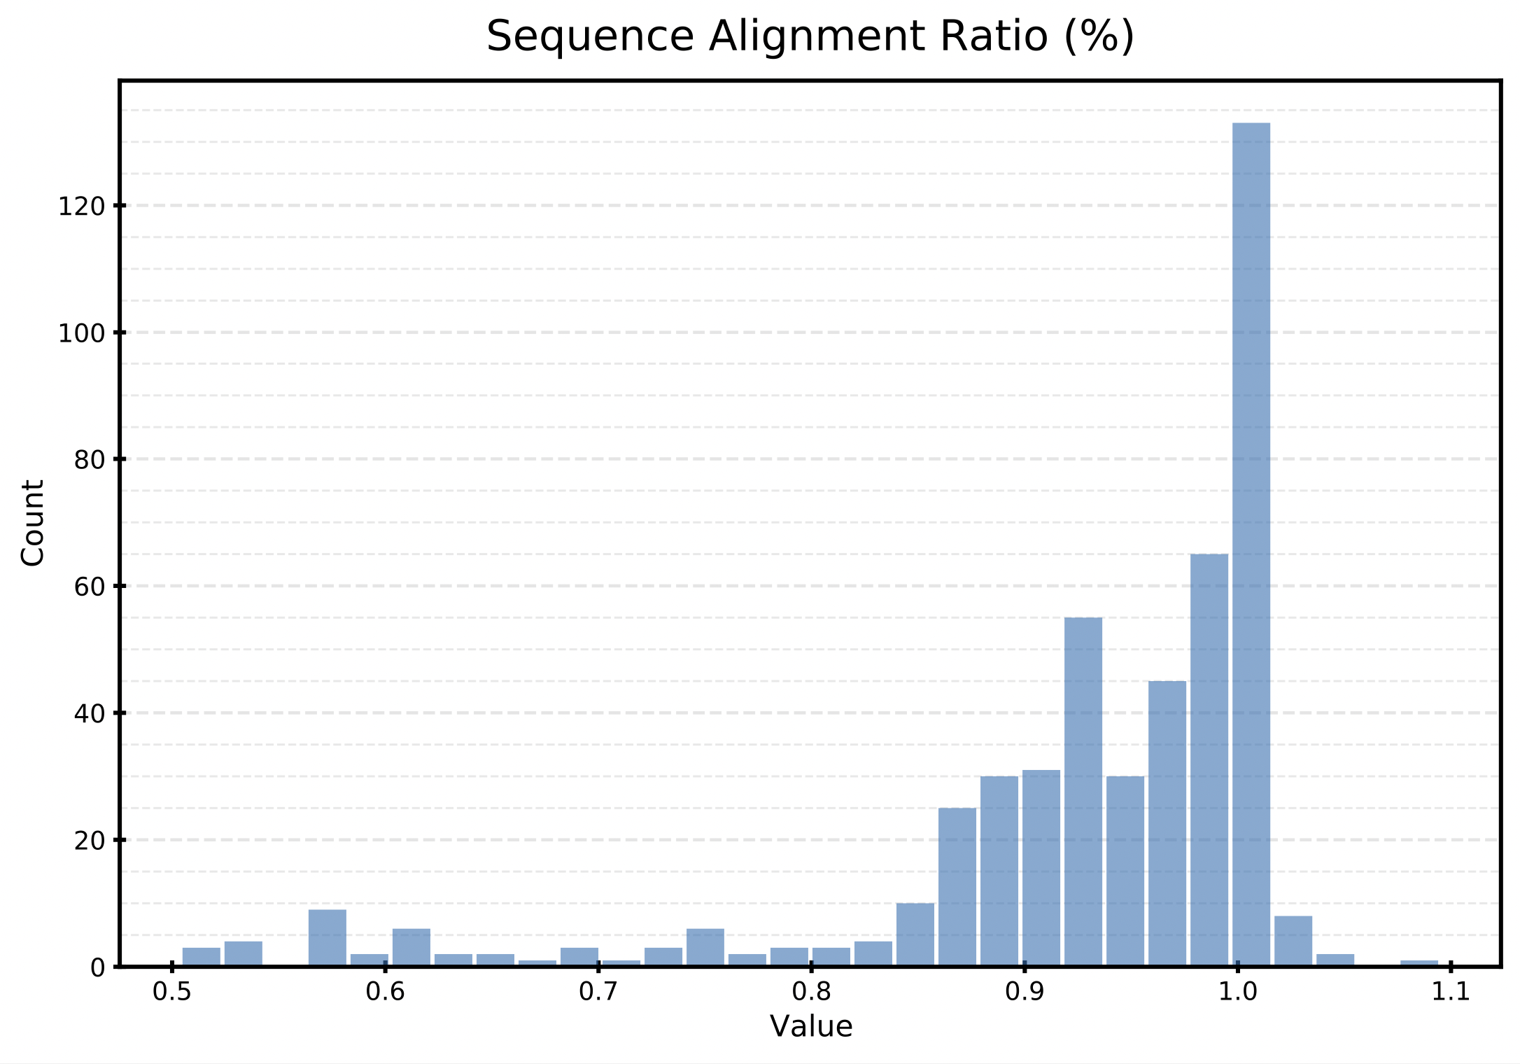
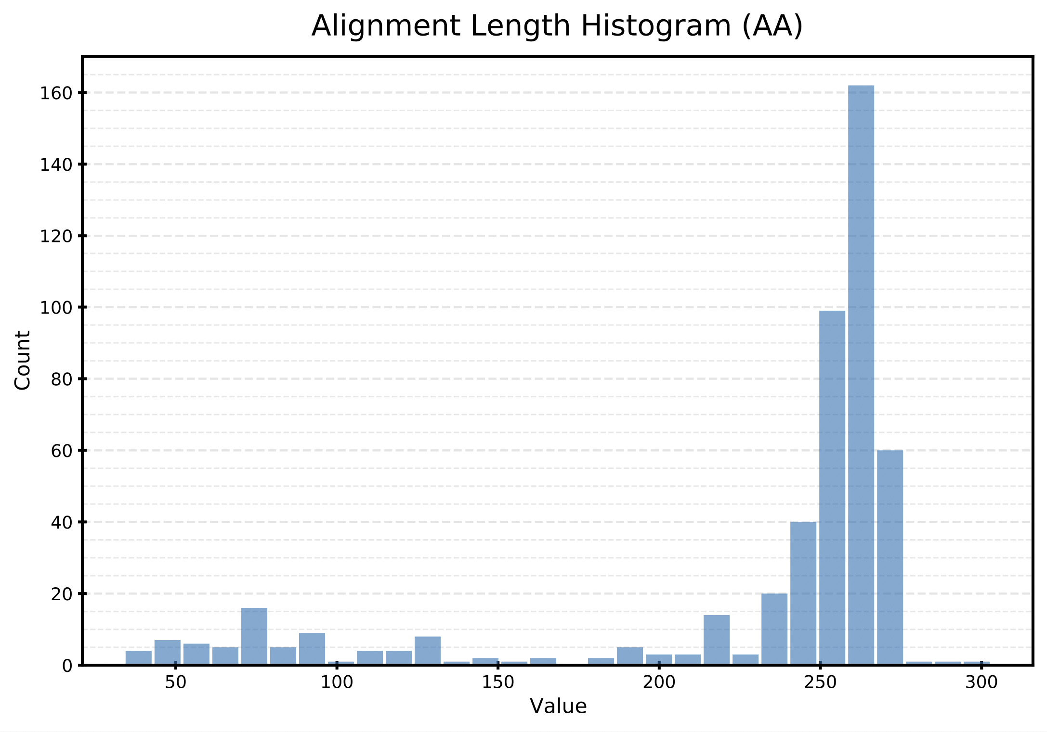
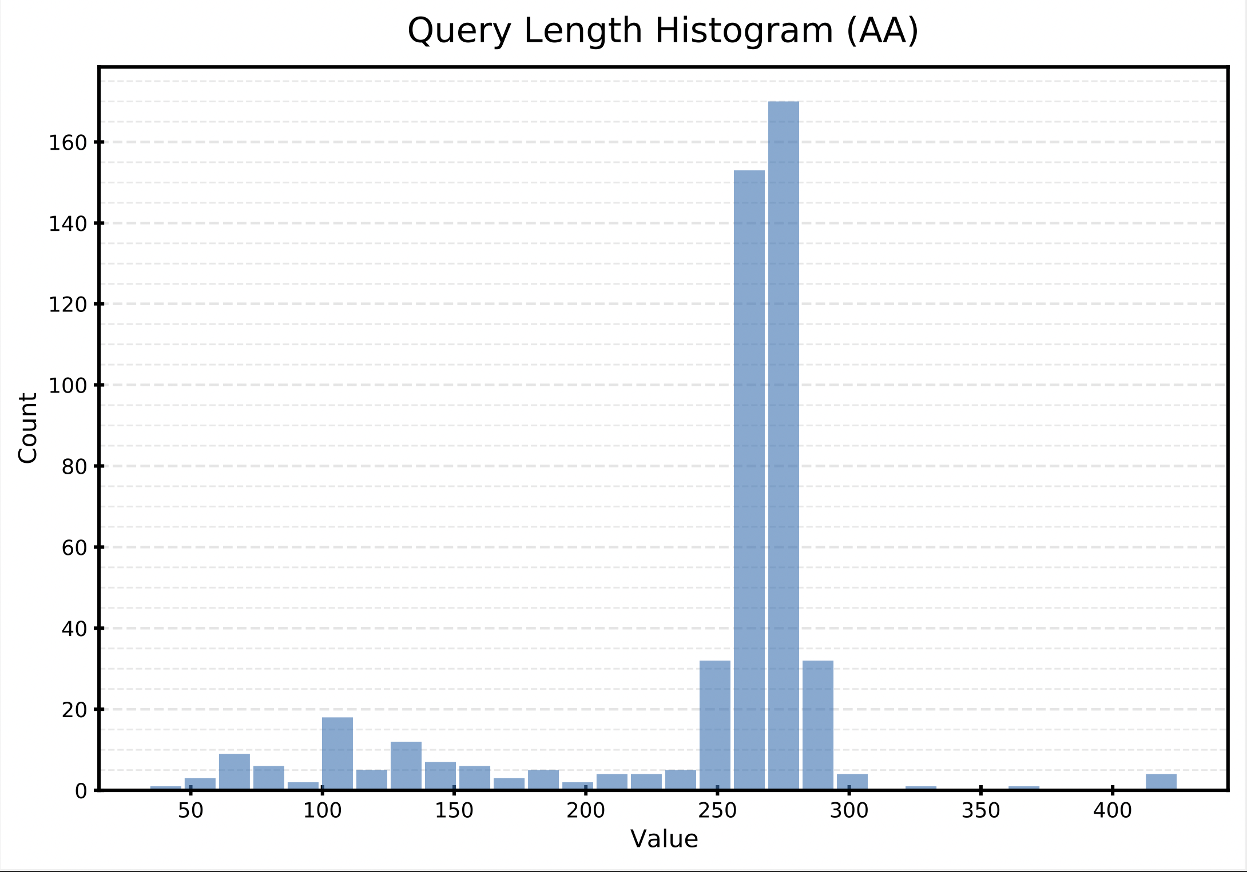
Histograms of Blast Filtering Parameters Post Filtering. Can be used to inform further filtering if necessary.
Filter Results:
Total number of entries in blast file: 5654
Number of entries failing the filters: 3980
Number of entries passing the filters: 1674
Number of duplicate blast matches passing filter to remove: 1185
Number of best hit entries written to new file: 489

Slide 7
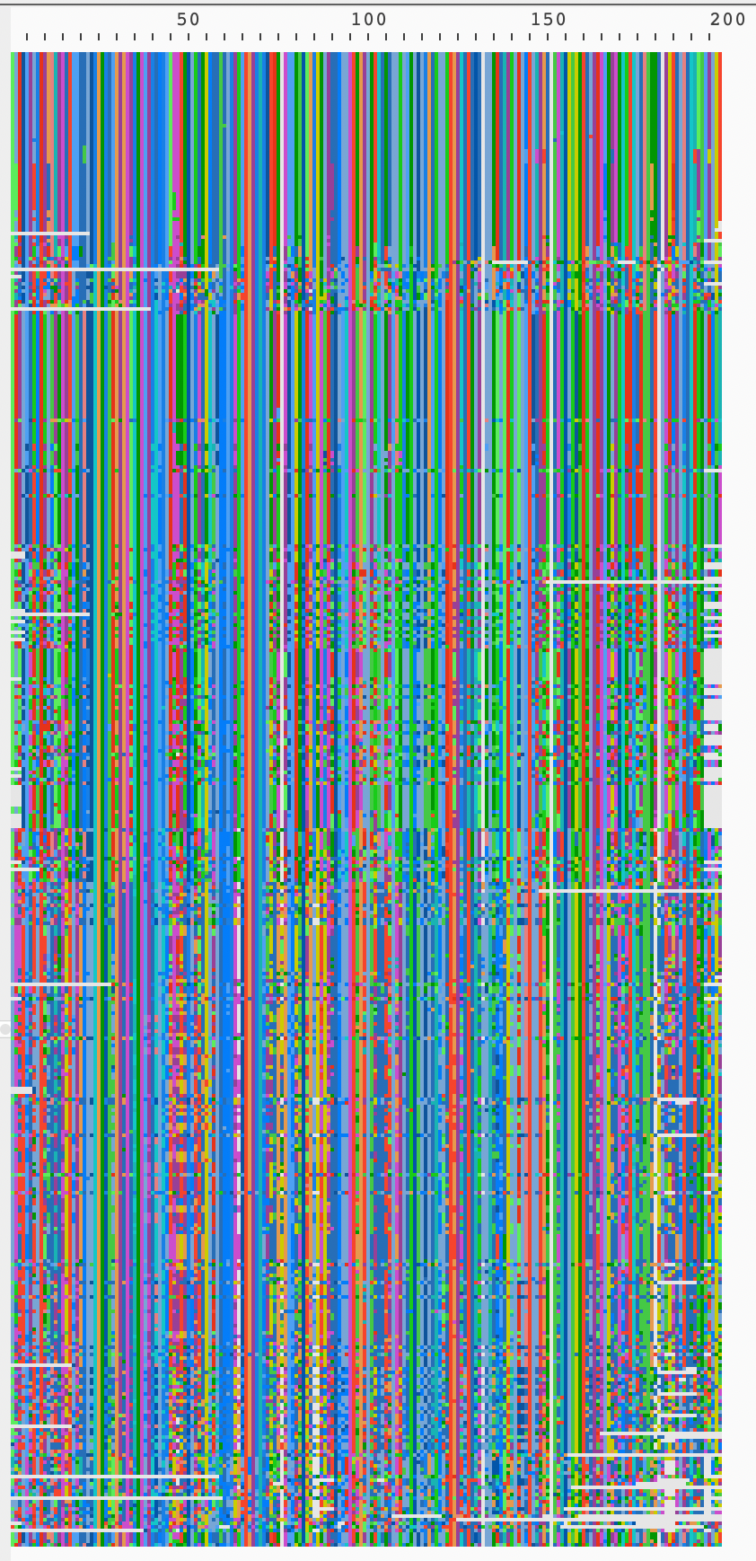
Alignment AFTER cleaning with TrimAL AND Blast filtering AND deduplication.
> qsub -v input=01_Retrieved_Sequence/LnuF_Blast_Similar_vs_Verified_blast_fltrd.fasta.aln,output=01_Retrieved_Sequence/trimal_LnuF_Blast_Similar_vs_Verified_blast_fltrd.fasta.aln ../00b_PBS/00c_TrimAl.pbs TrimAl removes an additional 73 sequences determined to have spurious alignments from 489 in the blast filtered file to 416 in this alignment.

Slide 8
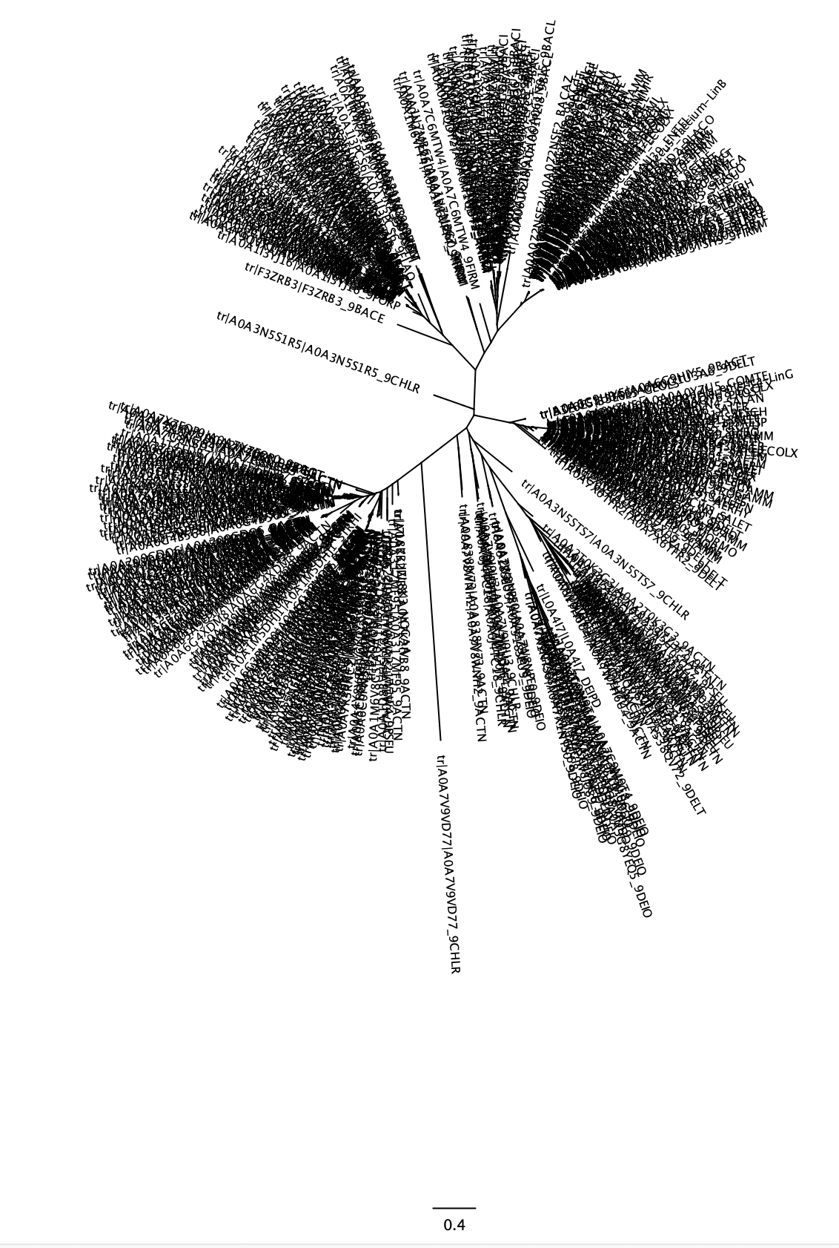
K-Means Cluster 7
Nucleotidyltransferase
Paenibafillus, Oceanobacillus, Geomicrobium, etc.
LnuG
K-Means Cluster 3
Lincosamide nucleotidyltransferase (LnuG)Enterococcus, Staphylococcus, Ecoli, Salmonella, Proteus, Acinetobacter, Listeria, etc
LnuB
K-Means Cluster 16 & 1
LnuF
Myroides, Flavobacterium, Empedobacter, Bacteroidales
K-Means Cluster 13
Lincosamide nucleotidyltransferase (LnuB)
Enterococcus, Sptreptococcus, Lactobacillus, Clostriduim, etc.
Model 1: LnuF
Positive
LnuF_1 & LnuF_2
Negative
K-Means Cluster 4
Lincosamide nucleotidyltransferase (LnuF)
Salmonella, Ecoli, Kelbsiella, Providencia, Proteus etc
LnuF_3
K-Means Cluster 9 & 15 & 5
DNA Polymerase subunit beta and
Lincosamide nucleotidyltransferase.
Streptomyces
K-Means Cluster 12-10, 8, 2
Lincosamide nucleotidyltransferase
Actinoplanes, Chloroflexia, Rubrobacteraceae, Delinococcus, Actinobacteria, Streptomyces

Slide 9
K-Means Cluster 7
Nucleotidyltransferase
Paenibafillus, Oceanobacillus, Geomicrobium, etc.
LnuG
K-Means Cluster 3
Lincosamide nucleotidyltransferase (LnuG)Enterococcus, Staphylococcus, Ecoli, Salmonella, Proteus, Acinetobacter, Listeria, etc
LnuB
K-Means Cluster 16 & 1
LnuF
Myroides, Flavobacterium, Empedobacter, Bacteroidales
K-Means Cluster 13
Lincosamide nucleotidyltransferase (LnuB)
Enterococcus, Sptreptococcus, Lactobacillus, Clostriduim, etc.
Model 2: LnuF+
Positive
LnuF_1 & LnuF_2
Negative
K-Means Cluster 4
Lincosamide nucleotidyltransferase (LnuF)
Salmonella, Ecoli, Kelbsiella, Providencia, Proteus etc
LnuF_3
K-Means Cluster 9 & 15 & 5
DNA Polymerase subunit beta and
Lincosamide nucleotidyltransferase.
Streptomyces
K-Means Cluster 12-10, 8, 2
Lincosamide nucleotidyltransferase
Actinoplanes, Chloroflexia, Rubrobacteraceae, Delinococcus, Actinobacteria, Streptomyces

Slide 10
K-Means Cluster 7
Nucleotidyltransferase
Paenibafillus, Oceanobacillus, Geomicrobium, etc.
LnuG
K-Means Cluster 3
Lincosamide nucleotidyltransferase (LnuG)Enterococcus, Staphylococcus, Ecoli, Salmonella, Proteus, Acinetobacter, Listeria, etc
LnuB
K-Means Cluster 16 & 1
LnuF
Myroides, Flavobacterium, Empedobacter, Bacteroidales
K-Means Cluster 13
Lincosamide nucleotidyltransferase (LnuB)
Enterococcus, Sptreptococcus, Lactobacillus, Clostriduim, etc.
Model 3: LnuF++
Positive
LnuF_1 & LnuF_2
Negative
K-Means Cluster 4
Lincosamide nucleotidyltransferase (LnuF)
Salmonella, Ecoli, Kelbsiella, Providencia, Proteus etc
LnuF_3
K-Means Cluster 9 & 15 & 5
DNA Polymerase subunit beta and
Lincosamide nucleotidyltransferase.
Streptomyces
K-Means Cluster 12-10, 8, 2
Lincosamide nucleotidyltransferase
Actinoplanes, Chloroflexia, Rubrobacteraceae, Delinococcus, Actinobacteria, Streptomyces

Slide 11
K-Means Cluster 7
Nucleotidyltransferase
Paenibafillus, Oceanobacillus, Geomicrobium, etc.
LnuG
K-Means Cluster 3
Lincosamide nucleotidyltransferase (LnuG)Enterococcus, Staphylococcus, Ecoli, Salmonella, Proteus, Acinetobacter, Listeria, etc
LnuB
K-Means Cluster 16 & 1
LnuF
Myroides, Flavobacterium, Empedobacter, Bacteroidales
K-Means Cluster 13
Lincosamide nucleotidyltransferase (LnuB)
Enterococcus, Sptreptococcus, Lactobacillus, Clostriduim, etc.
Model 4: LnuB+G
Positive
LnuF_1 & LnuF_2
Negative
K-Means Cluster 4
Lincosamide nucleotidyltransferase (LnuF)
Salmonella, Ecoli, Kelbsiella, Providencia, Proteus etc
LnuF_3
K-Means Cluster 9 & 15 & 5
DNA Polymerase subunit beta and
Lincosamide nucleotidyltransferase.
Streptomyces
K-Means Cluster 12-10, 8, 2
Lincosamide nucleotidyltransferase
Actinoplanes, Chloroflexia, Rubrobacteraceae, Delinococcus, Actinobacteria, Streptomyces

Slide 12
K-Means Cluster 7
Nucleotidyltransferase
Paenibafillus, Oceanobacillus, Geomicrobium, etc.
LnuG
K-Means Cluster 3
Lincosamide nucleotidyltransferase (LnuG)Enterococcus, Staphylococcus, Ecoli, Salmonella, Proteus, Acinetobacter, Listeria, etc
LnuB
K-Means Cluster 16 & 1
LnuF
Myroides, Flavobacterium, Empedobacter, Bacteroidales
K-Means Cluster 13
Lincosamide nucleotidyltransferase (LnuB)
Enterococcus, Sptreptococcus, Lactobacillus, Clostriduim, etc.
Model 5: LnuB-G
Positive
LnuF_1 & LnuF_2
Negative
K-Means Cluster 4
Lincosamide nucleotidyltransferase (LnuF)
Salmonella, Ecoli, Kelbsiella, Providencia, Proteus etc
LnuF_3
K-Means Cluster 9 & 15 & 5
DNA Polymerase subunit beta and
Lincosamide nucleotidyltransferase.
Streptomyces
K-Means Cluster 12-10, 8, 2
Lincosamide nucleotidyltransferase
Actinoplanes, Chloroflexia, Rubrobacteraceae, Delinococcus, Actinobacteria, Streptomyces

Slide 13
K-Means Cluster 7
Nucleotidyltransferase
Paenibafillus, Oceanobacillus, Geomicrobium, etc.
LnuG
K-Means Cluster 3
Lincosamide nucleotidyltransferase (LnuG)Enterococcus, Staphylococcus, Ecoli, Salmonella, Proteus, Acinetobacter, Listeria, etc
LnuB
K-Means Cluster 16 & 1
LnuF
Myroides, Flavobacterium, Empedobacter, Bacteroidales
K-Means Cluster 13
Lincosamide nucleotidyltransferase (LnuB)
Enterococcus, Sptreptococcus, Lactobacillus, Clostriduim, etc.
Model 6: LnuG-B
Positive
LnuF_1 & LnuF_2
Negative
K-Means Cluster 4
Lincosamide nucleotidyltransferase (LnuF)
Salmonella, Ecoli, Kelbsiella, Providencia, Proteus etc
LnuF_3
K-Means Cluster 9 & 15 & 5
DNA Polymerase subunit beta and
Lincosamide nucleotidyltransferase.
Streptomyces
K-Means Cluster 12-10, 8, 2
Lincosamide nucleotidyltransferase
Actinoplanes, Chloroflexia, Rubrobacteraceae, Delinococcus, Actinobacteria, Streptomyces

Slide 14
K-Means Cluster 7
Nucleotidyltransferase
Paenibafillus, Oceanobacillus, Geomicrobium, etc.
LnuG
K-Means Cluster 3
Lincosamide nucleotidyltransferase (LnuG)Enterococcus, Staphylococcus, Ecoli, Salmonella, Proteus, Acinetobacter, Listeria, etc
LnuB
K-Means Cluster 16 & 1
LnuF
Myroides, Flavobacterium, Empedobacter, Bacteroidales
K-Means Cluster 13
Lincosamide nucleotidyltransferase (LnuB)
Enterococcus, Sptreptococcus, Lactobacillus, Clostriduim, etc.
Model 7: LnuBG+
Positive
LnuF_1 & LnuF_2
Negative
K-Means Cluster 4
Lincosamide nucleotidyltransferase (LnuF)
Salmonella, Ecoli, Kelbsiella, Providencia, Proteus etc
LnuF_3
K-Means Cluster 9 & 15 & 5
DNA Polymerase subunit beta and
Lincosamide nucleotidyltransferase.
Streptomyces
K-Means Cluster 12-10, 8, 2
Lincosamide nucleotidyltransferase
Actinoplanes, Chloroflexia, Rubrobacteraceae, Delinococcus, Actinobacteria, Streptomyces

Slide 15
K-Means Cluster 7
Nucleotidyltransferase
Paenibafillus, Oceanobacillus, Geomicrobium, etc.
LnuG
K-Means Cluster 3
Lincosamide nucleotidyltransferase (LnuG)Enterococcus, Staphylococcus, Ecoli, Salmonella, Proteus, Acinetobacter, Listeria, etc
LnuB
K-Means Cluster 16 & 1
LnuF
Myroides, Flavobacterium, Empedobacter, Bacteroidales
K-Means Cluster 13
Lincosamide nucleotidyltransferase (LnuB)
Enterococcus, Sptreptococcus, Lactobacillus, Clostriduim, etc.
Model 7: LnuBG++
Positive
LnuF_1 & LnuF_2
Negative
K-Means Cluster 4
Lincosamide nucleotidyltransferase (LnuF)
Salmonella, Ecoli, Kelbsiella, Providencia, Proteus etc
LnuF_3
K-Means Cluster 9 & 15 & 5
DNA Polymerase subunit beta and
Lincosamide nucleotidyltransferase.
Streptomyces
K-Means Cluster 12-10, 8, 2
Lincosamide nucleotidyltransferase
Actinoplanes, Chloroflexia, Rubrobacteraceae, Delinococcus, Actinobacteria, Streptomyces

Slide 16
K-Means Cluster 7
Nucleotidyltransferase
Paenibafillus, Oceanobacillus, Geomicrobium, etc.
LnuG
K-Means Cluster 3
Lincosamide nucleotidyltransferase (LnuG)Enterococcus, Staphylococcus, Ecoli, Salmonella, Proteus, Acinetobacter, Listeria, etc
LnuB
K-Means Cluster 16 & 1
LnuF
Myroides, Flavobacterium, Empedobacter, Bacteroidales
K-Means Cluster 13
Lincosamide nucleotidyltransferase (LnuB)
Enterococcus, Sptreptococcus, Lactobacillus, Clostriduim, etc.
Model 8: LnuFBG+++
Positive
LnuF_1 & LnuF_2
Negative
K-Means Cluster 4
Lincosamide nucleotidyltransferase (LnuF)
Salmonella, Ecoli, Kelbsiella, Providencia, Proteus etc
LnuF_3
K-Means Cluster 9 & 15 & 5
DNA Polymerase subunit beta and
Lincosamide nucleotidyltransferase.
Streptomyces
K-Means Cluster 12-10, 8, 2
Lincosamide nucleotidyltransferase
Actinoplanes, Chloroflexia, Rubrobacteraceae, Delinococcus, Actinobacteria, Streptomyces

Slide 17
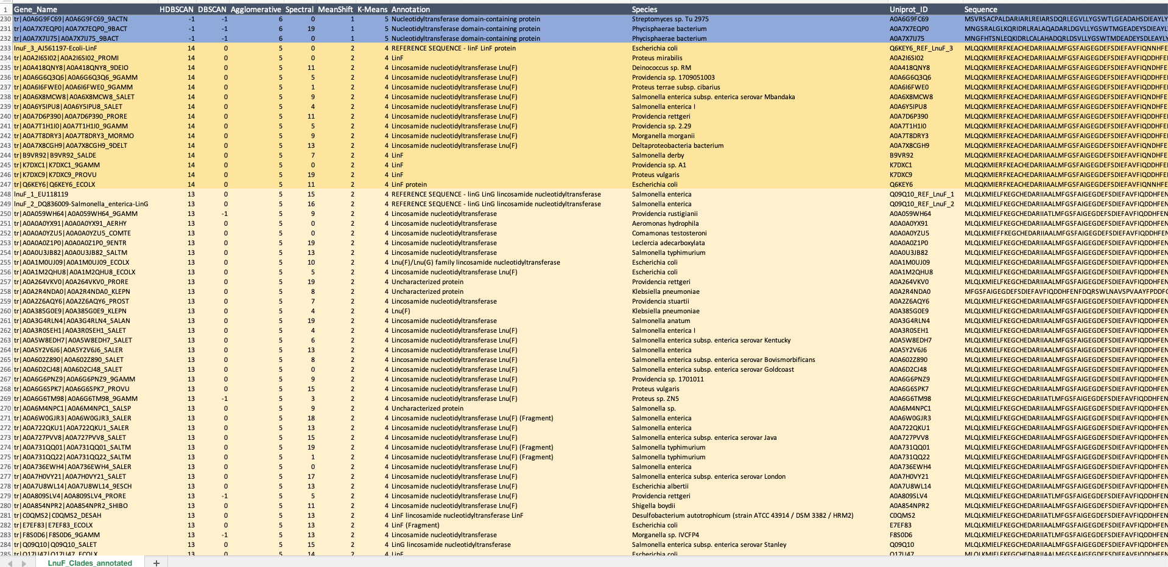
We can open the tsv in Excel and have all the data. Now for the manual work and decision making…

